Slide 1
EOC-OOP
TERM PROJECT
Presented by BATCH-A TEAM-11

Slide 2
TEAM MEMBERS
VIKHYAT BANSAL (CB.EN.U4AIE21076)
MARREDDY MOHIT SASANK REDDY (CB.EN.U4AIE21031)
VIGNESH (CB.EN.U4AIE21075)
Yarram Sri Sathwik Reddy(CB.EN.U4AIE21077)

Slide 3
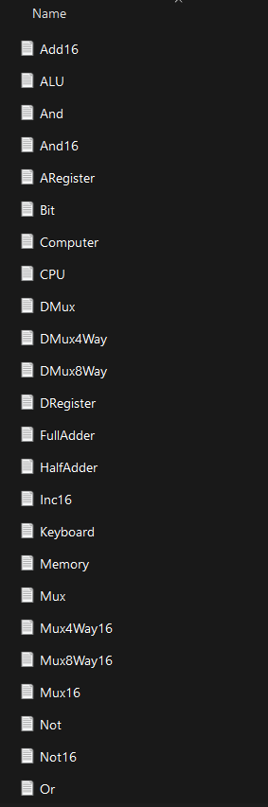
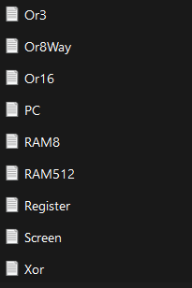
PART-A - EOC
Design and implement 16-bit HACK CPU
HDL Files in our folder required for making CPU

Slide 4
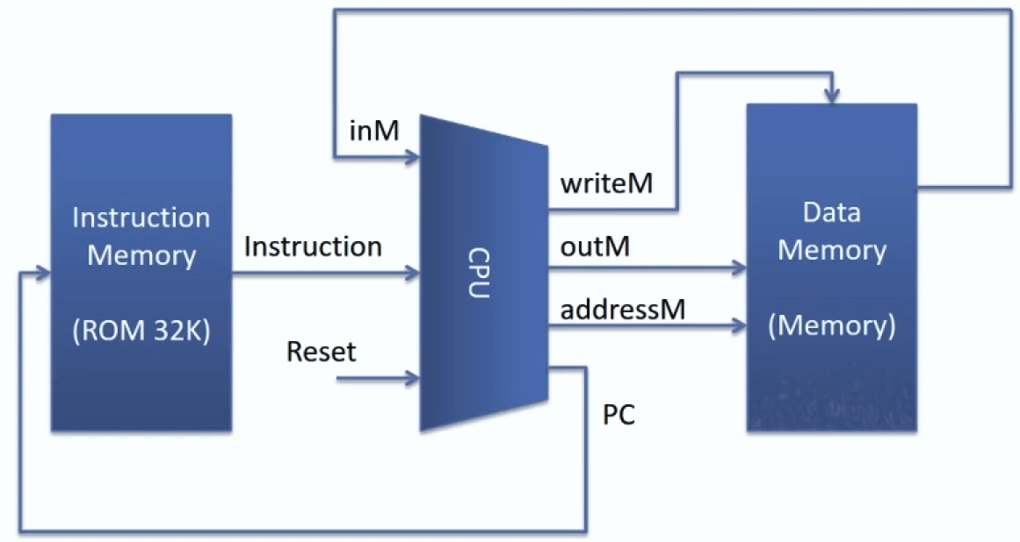
Proposed implementation of the topmost Computer chip
Data Memory is readable and rewritable but instruction memory is read only.

Slide 5
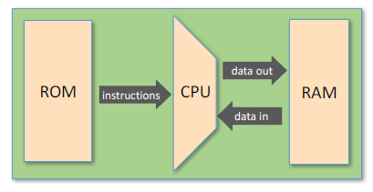
Two types of instructions
16-bit A-instructions
16-bit C-instructions
Hack program = sequence of instructions written in the Hack machine language

Slide 6
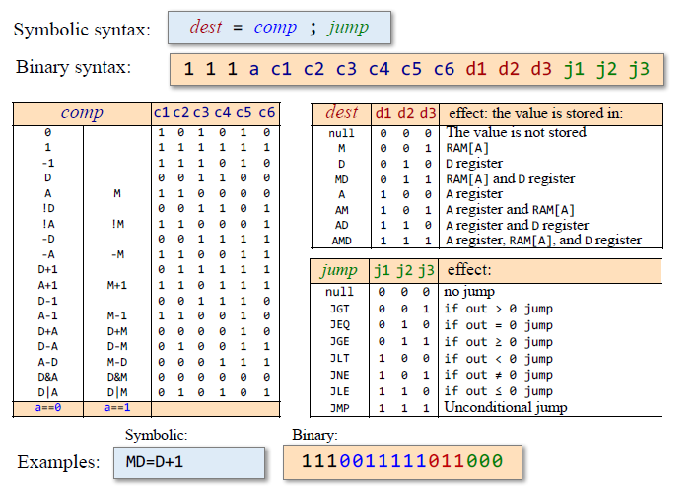
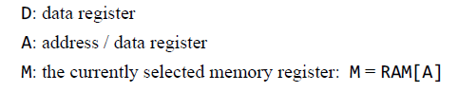
The C-instruction specification
Left most bit must 1 be to activate C-Instruction

Slide 7
Hack CPU Design

Slide 8
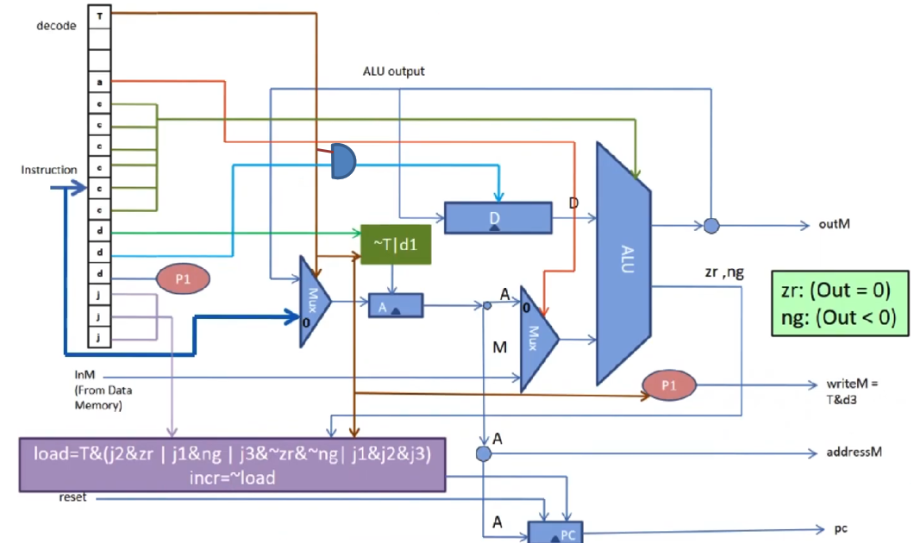
Generated EMF and Speed of rotation
We will work our way from T to j1,j2,j3 to see how hack CPU is working ~T|d1 (~T + T.d1) = | is a symbol for OR ~ is a symbol for complement Instruction bit count starts from below and move upwards from 0 to 15 i.e. j1 = 0 and T = 15

Slide 9
WORKING OF HACK CPU DESIGN DIAGRAM
Starting from ALU, it has two input bits x and y and 6 control bits(from 6 to 11)(represented by green line) and output is ALU output and status bit of zr and ng depending on the output , x input comes from D-Register and y input comes either from A register or Memory[M].
Bit-12(marked as a) (selection line for MUX 2) specifies whether y input comes from memory or A-Register(Address Register). Remember , when a==1 (bit-12 is 1) inM is taken, when a==0 address register is taken as y input.
T bit is given as selection line to MUX-1 so to decide whether A-instruction or C-Instruction is going to be used. When T==0 , input to the mux-1 is going to be bit from 0 to 14 which are 15 bit binary constant.
When T==1, input to the mux-1 will be nothing but ALU output Let us talk about how A-Register is loaded, The load of A-Register that is (~T + T.d1) , we need high load( must be 1) to work with A-Register , now there are two possible cases i.e. T==0 and T==1 , so when T==0 load will be high but when T==1 then in that case d1 = 1 is a necessary condition so that load comes out to be high and this can be confirmed after seeing the table given in C-Instruction slide. Let us talk about how D-Register is loaded, The load of D-register will be high when d2 line is high and T must be 1 that is why both T and d2 are passed through an AND gate . Same can be noticed when the diagram is seen carefully . When d3 == 1 and T == 1 using AND GATE, output is given on writeM (M = RAM[A]).

Slide 10
Another important component is PC(program counter) Firstly we must remember the priority order in which PC works i.e. reset , load, inc. Load is a situation where we have some C-Instruction as for loading to a particular address we need to encounter some jump instruction which is possible only in C-Instruction. Load will only be enabled when there is some kind of jump instruction. If you don’t require to jump to any instruction and want to move ahead one by one we need to remember that inc = ~load (load is low) meaning that increment is only possible when load == 0 or load is low, and increment comes last in priority order of program counter. NOW for load to be high we will see 4 situation for JUMP i.e Unconditional jump, Output = 0 ,>0 ,<0 j3 == 1 (when output > 0) j2 == 1 (when output = 0) j1 == 1 (when output < 0) j1,j2,j3 == 1 (unconditional jump) Now when we see load equation carefully we will see that T must be high or ==1 and 1 out of any 4 conditions in brackets must be high or == 1 to set load as high or ==1 . Now for increment there are two possibilities :- When T == 0, it will be an A-Instruction and load == 0 which will lead to taking of all 15 bits and it will come in program counter and increment will happen one by one. When T == 1, it will be a C-Instruction but all jump condition are equal to zero which makes load == 0 and leads to increment function in program counter.
OUR DIAGRAM WORKING IS COMPLETE LET US MOVE TOWARDS HDL CODE

Slide 11
Logic Flow Chart for HDL CODE

Slide 12
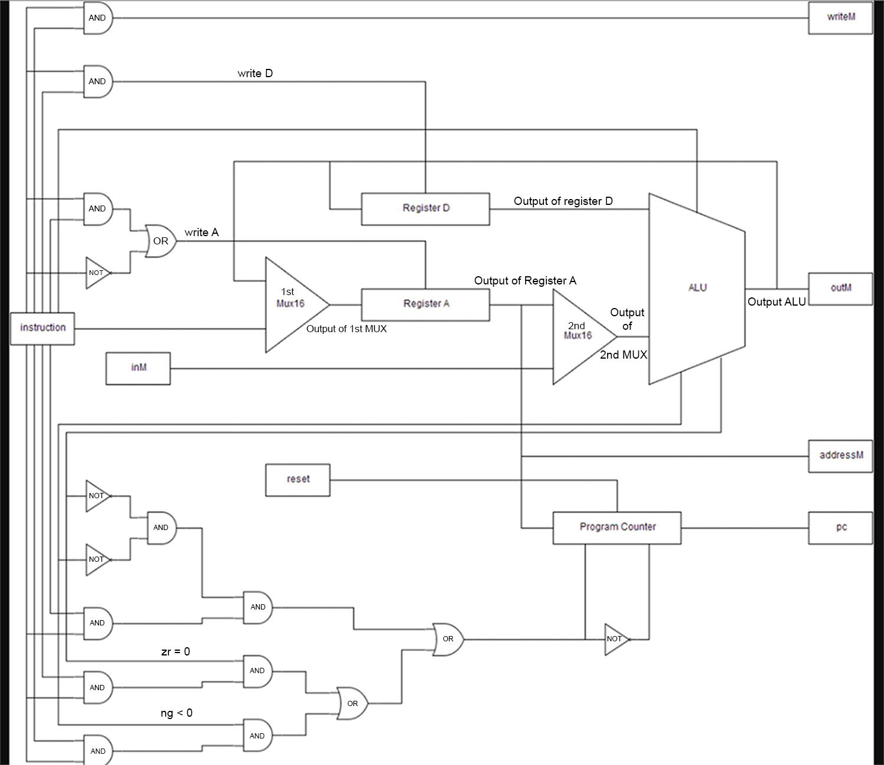
Generated EMF and Speed of rotation

Slide 13
HDL CODE(CPU)

Slide 14
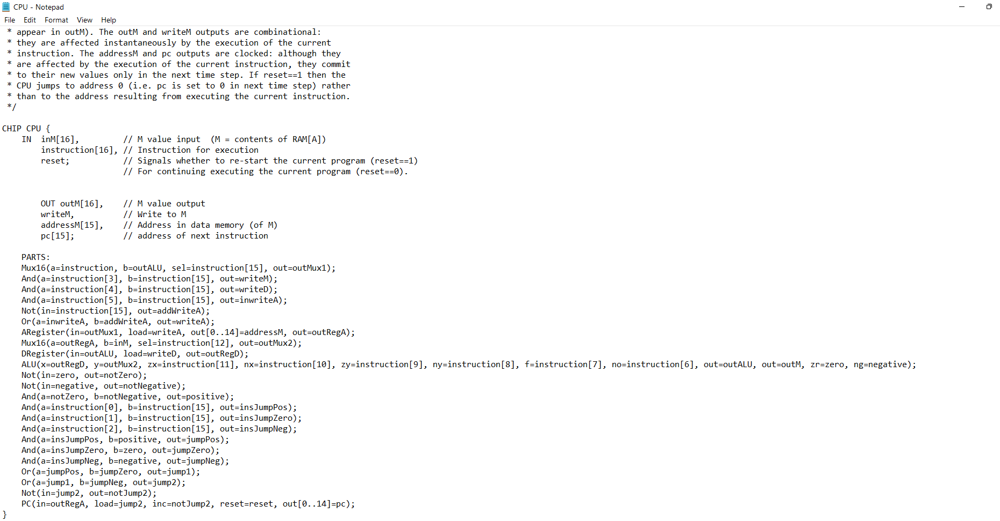

Slide 15
OUTPUT

Slide 16
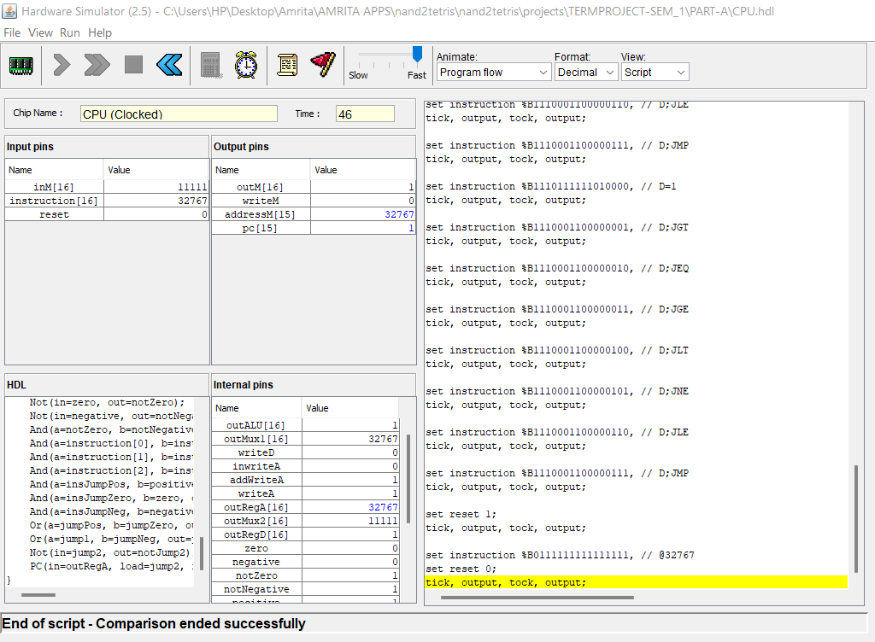

Slide 17
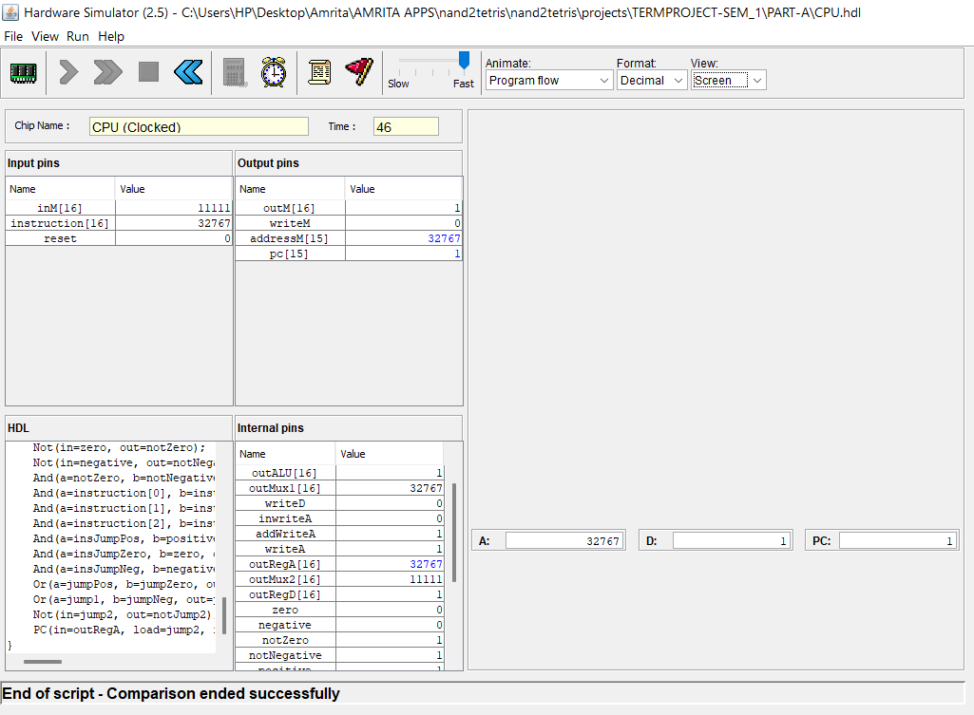

Slide 18
HDL CODE(Computer)

Slide 19
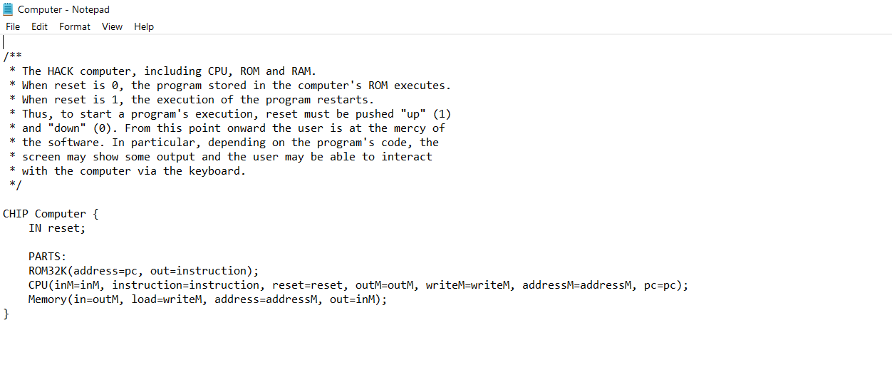

Slide 20
OUTPUT (TESTING HACK FILES)

Slide 21
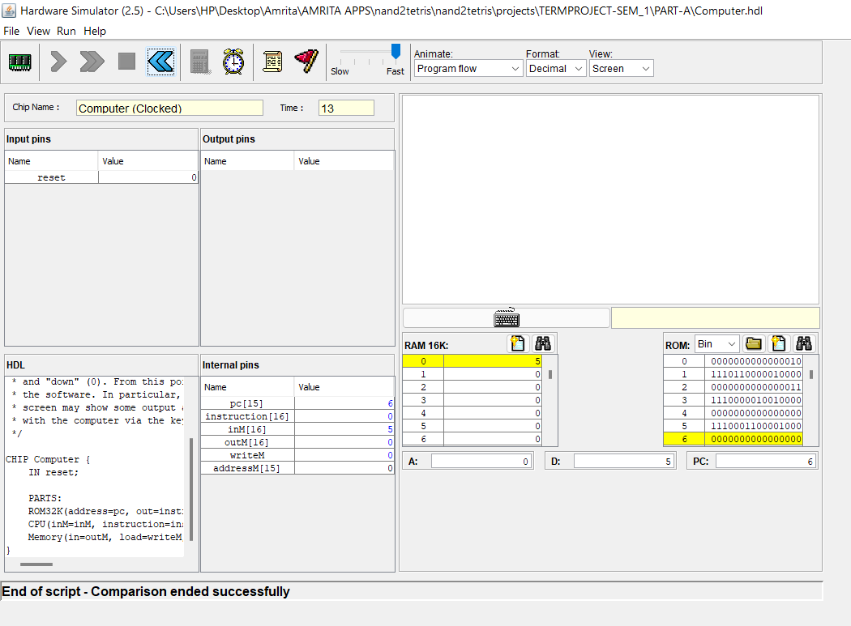

Slide 22
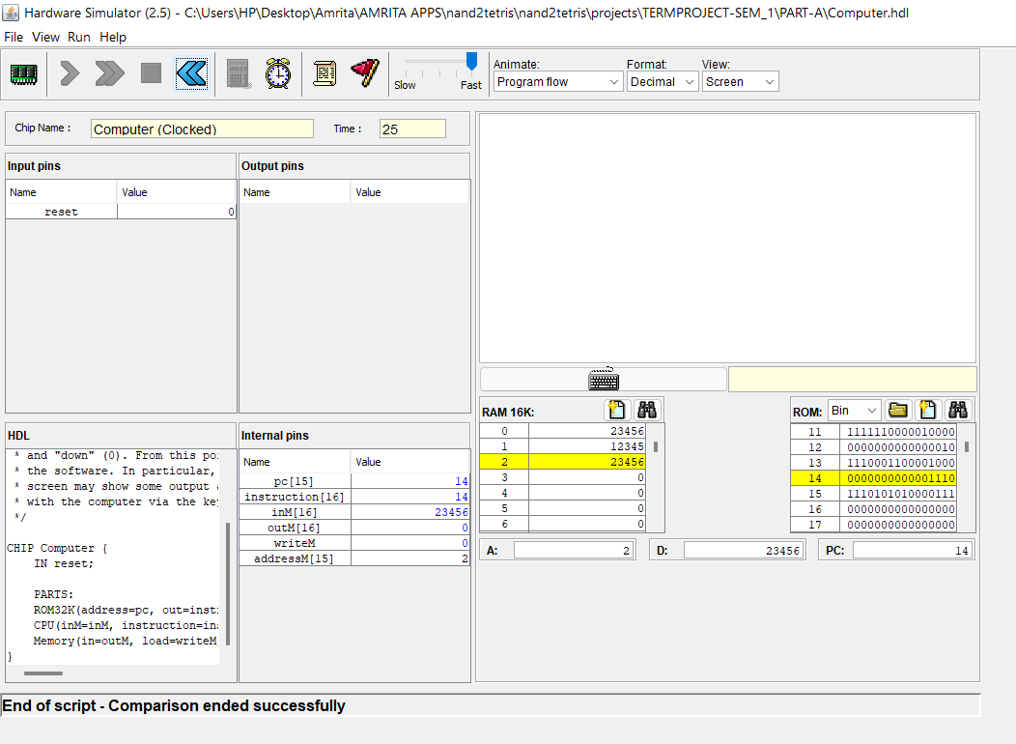

Slide 23
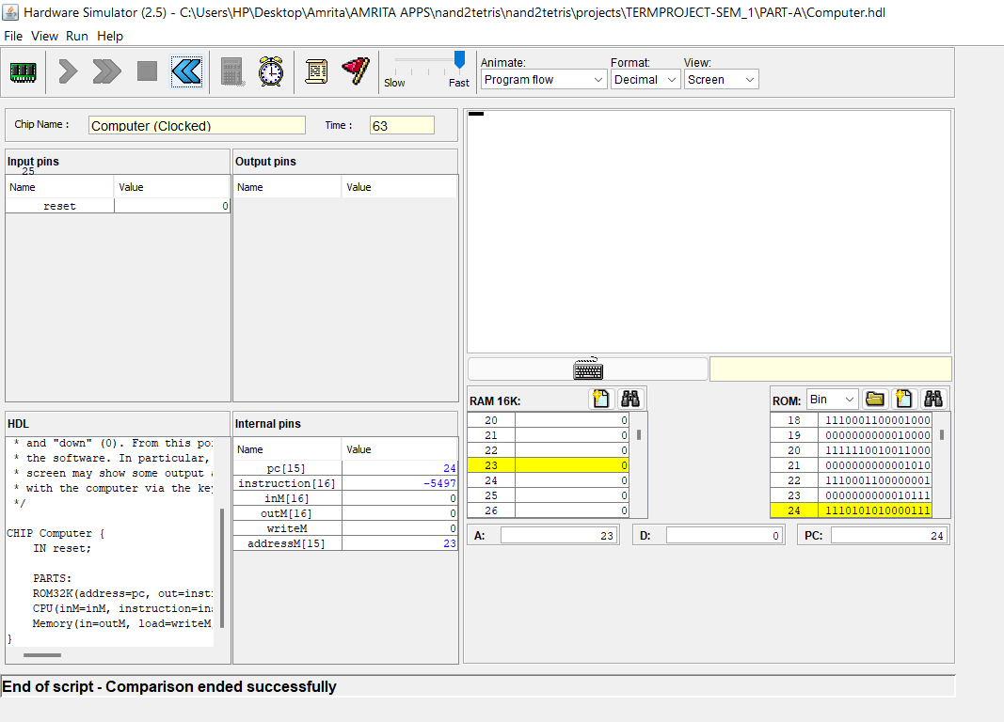

Slide 24
PART-B-EOC
Design and implement a synchronous BCD counter using JK Flip flop

Slide 25
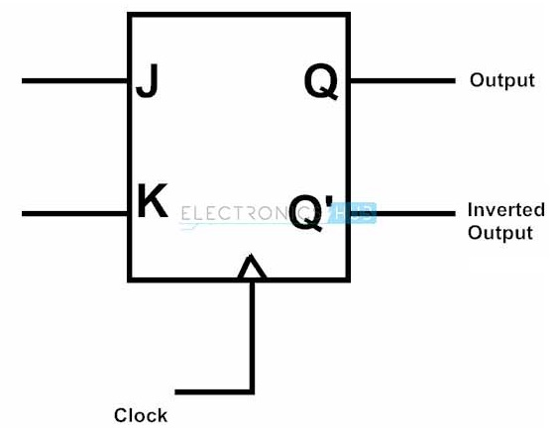
JK Flip Flop
Introduction
JK flip – flop is named after Jack Kilby, the electrical engineer who invented it.
A JK flip – flop is called a Universal Programmable flip – flop because, using its inputs J, K Preset and Clear, function of any other flip – flop can be imitated.
A JK flip – flop is the modification of SR flip – flop with no illegal state or values .

Slide 26
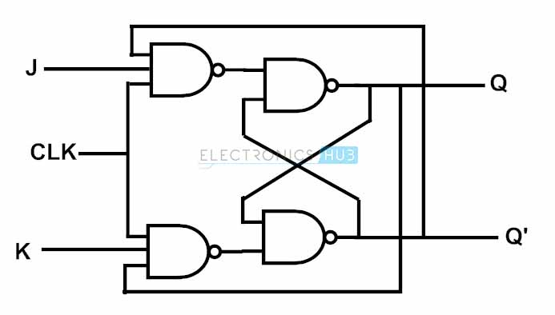
JK flip flop Logic Diagram
JK flip – flop logic diagram is shown in the below figure. JK flip – flop is a modified version of SR flip – flop. Logic diagram consists of four input NAND gates and the inputs are replaced with J and K from S and R.
The design of the JK flip – flop is such that the three inputs to one NAND gate are J, clock signal along with a feedback signal from Q’ and the three inputs to the other NAND are K, clock signal along with a feedback signal from Q. This arrangement eliminates the indeterminate state in SR flip – flop.

Slide 27
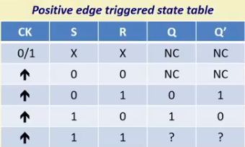
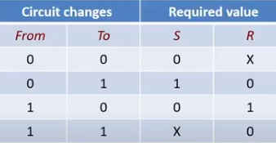
State Table and Excitation Table
NC= No Change In row 1 Ck (clock) can be 0 or 1 and input in form of S,R can be anything there will be no change in output . Other than that ck is going to be 1 and input and output is same as Set-Reset Latch.
From (t) To (t+1) is denoted by Q(t) and Q(t+1) respectively and the excitation table can be created using characteristic table.

Slide 28
Operation
Case 1 : When both the inputs J and K are LOW, then Q returns its previous state value i.e. it holds the previous data.
When we apply a clock pulse to the J K flip flop and the J input is low then irrespective of the other NAND gates, the NAND gate-1 output becomes HIGH. In the same manner, if the K input is low then output of NAND gate-2 is also HIGH. So thus the output remains in the same state i.e. no change in the state of flip flop.
Case 2 : When J is LOW and K is HIGH, then flip flop will be in Reset state i.e. Q = 0, Q’ = 1.
When we apply a clock pulse to the J K flip flop and the inputs are J is low and K is high the output of the NAND gate connected to J input becomes 1. Then Q becomes 0. This will reset the flip flop again to its previous state. So the Flip flop will be in RESET state.
Case 3 : When J is HIGH and K is LOW, then flip – flop will be in Set state i.e. Q = 1, Q’ = 0
When we apply a clock pulse to the J K flip flop and the inputs are J is high and K is low the output of the NAND gate connected to K input becomes 1. Then Q’ becomes 0. This will set the flip flop with the high clock input. So the Flip flop will be in SET state.
Case 4 : When both the inputs J and K are HIGH, then flip – flop is in Toggle state. This means that the output will complement of the previous state.

Slide 29
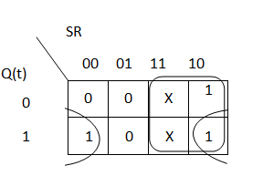
Characteristic Table
S | R | Q(t) | Q(t+1)
0 | 0 | 0 | 0
0 | 0 | 1 | 1
0 | 1 | 0 | 0
0 | 1 | 1 | 0
1 | 0 | 0 | 1
1 | 0 | 1 | 1
1 | 1 | 0 | X
1 | 1 | 1 | X
Characteristic equation
Q(t+1)=R’ Q(t) + S

Slide 30
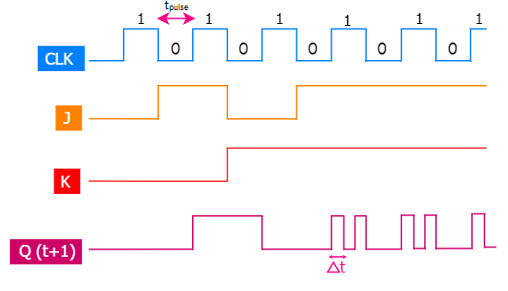
Race around condition
Occurs only in level triggered FF
Toggling the output more than once during the clock pulse is called Race around condition
Race around condition occurs in JK flip flop when both the inputs are 1 and the clock pulse width is greater than propagation delay of the FF
At level 1 it can be seen that previous input of J and K == 0 and Q(t) == 0 and current input is == 0 and Q(t+1) == 0(as for J,K ==0 output remains same as previous output).
From output diagram , it can be seen that at an instant output is changing regularly and this condition is called as race around condition.
At 4th level 1 we can see that input J and K == 1 and toggling is happening which cause some propagation delay (del(t)) and width of del(t) is less than width of clock pulse .

Slide 31
Overcoming Race around Condition
By using edge triggered flip flop . For example D-Flip Flop
By using clock signal whose pulse width is less than or equal to the propagation delay of the flip flops.

Slide 32
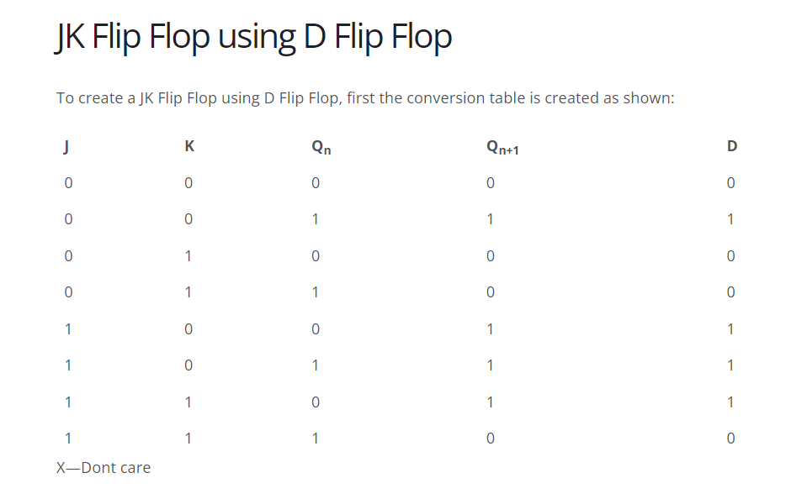
JK Flip Flop using D Flip Flop
D Flip Flop is primarily meant to provide delay as the output of this Flip Flop is same as the input. D Flip Flop can easily be made by using a SR Flip Flop or JK Flip Flop. But sometimes designers may be required to design other Flip Flops by using D Flip Flop. Here we discuss how to convert a D Flip Flop into JK and SR Flip Flops.
The first thing that needs to be done for converting one Flip Flop into another is to draw the truth table for both the Flip Flops. The next step is to create the equivalent K-Maps for the required outputs.

Slide 33
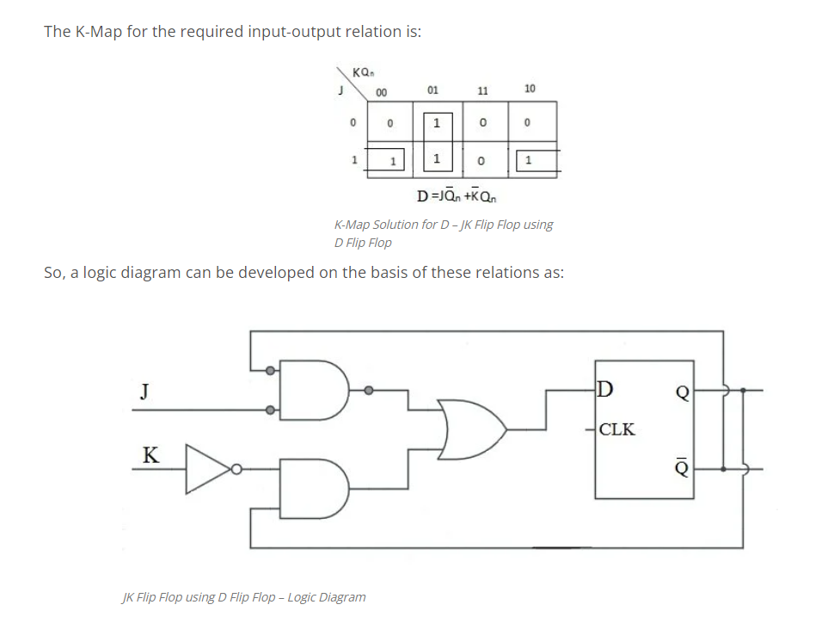
K-Map and Implementation Diagram for HDL Code

Slide 34
HDL CODE

Slide 35
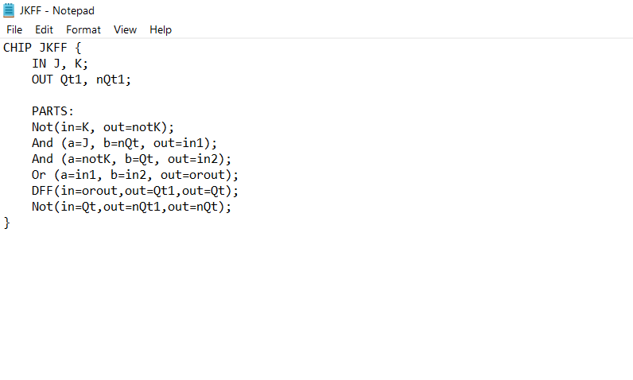

Slide 36
Synchronous Counter
In Asynchronous binary counter, we already know that the output of one counter stage is connected directly to the clock input of the next counter stage and so on along the chain.
The result of this is that the Asynchronous counter suffers from what is known as “Propagation Delay” in which the timing signal is delayed a fraction through each flip-flop.
However, with the Synchronous Counter, the external clock signal is connected to the clock input of EVERY individual flip-flop within the counter so that all of the flip-flops are clocked together simultaneously (in parallel) at the same time giving a fixed time relationship. In other words, changes in the output occur in “synchronization” with the clock signal.
The result of this synchronization is that all the individual output bits changing state at exactly the same time in response to the common clock signal with no ripple effect and therefore, no propagation delay.

Slide 37
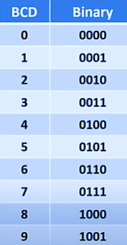
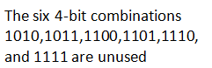
BCD – Binary Coded Decimal

Slide 38
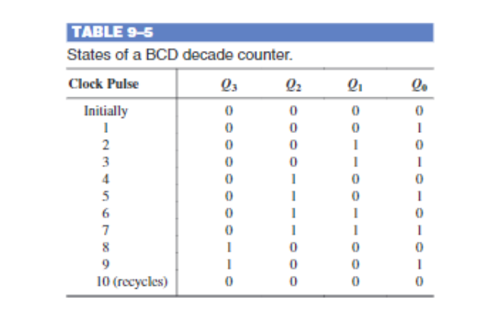
Synchronous BCD Counter
A binary coded decimal decade counter exhibits a truncated binary sequence and goes from 0000 through the 1001 state. Rather than going from the 1001 state to the 1010 state, it recycles to the 0000 state.

Slide 39
State Table for BCD Counter

Slide 40
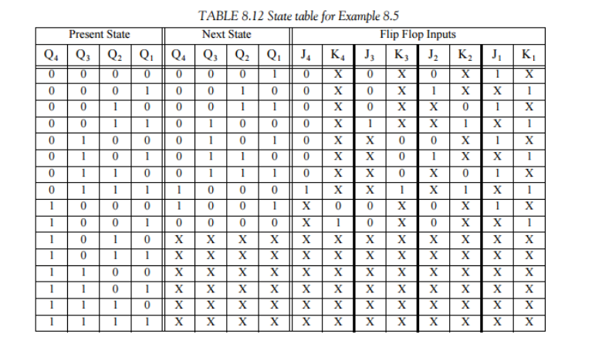
Remember here,(For help in slide 43)
Q₃ = Q₄ J₃ = J₄ K₃ = K₄ Q₂ = Q₃ J₂ = J₃ K₂ = K₃ Q₁ = Q₂ J₁ = J₂ K₁ = K₂ Q₀ = Q₁ J₀ = J₁ K₀ = K₁

Slide 41
K-Map for BCD Counter

Slide 42
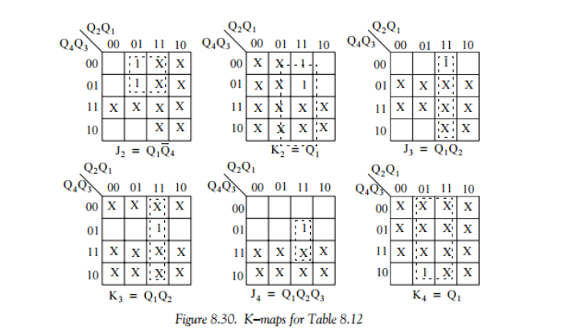
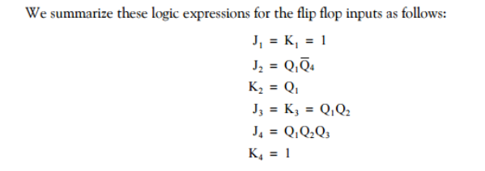

Slide 43
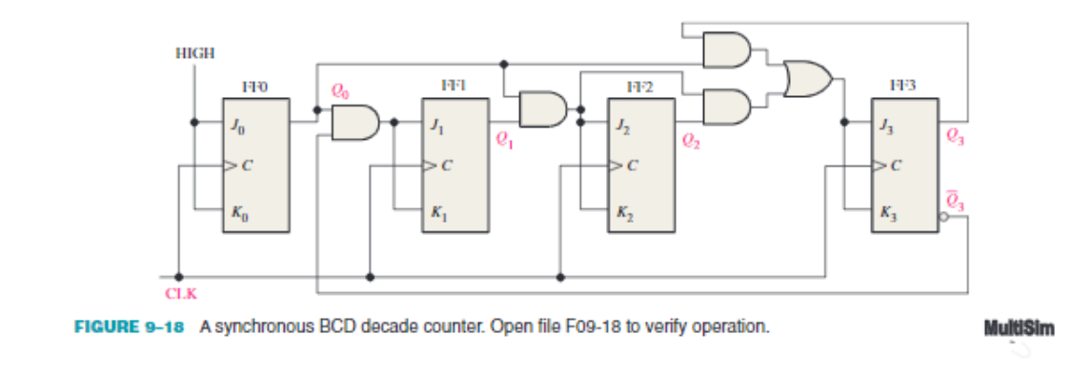
Working of Synchronous BCD Counter
The counter operation is shown by the sequence of states in Table 9–5.
First, notice that FF0 (Q0) toggles on each clock pulse, so the logic equation for its J0 and K0 inputs is
J₀=K₀=1.
This equation is implemented by connecting J0 and K0 to a constant HIGH level.
Next, notice in Table 9–5 that FF1 (Q1) changes on the next clock pulse each time when Q0=1 and Q3=0, so the logic equation for the J1 and K1 inputs is
J₁=K₁=Q₀Q₃’
This equation is implemented by ANDing Q0 and Q3 and connecting the gate output to the J1 and K1 inputs of FF1.
Flip-flop 2 (Q2) changes on the next clock pulse each time both Q0=1 and Q1=1. This requires an input logic equation as follows:
J₂=K₂=Q₀Q₁
This equation is implemented by ANDing Q0 and Q1 and connecting the gate output to the J2 and K2 inputs of FF2.
Finally, FF3 (Q3) changes to the opposite state on the next clock pulse each time Q0=1, Q1=1, and Q2=1 (state 7), or when Q0=1 and Q3=1 (state 9). The equation for this is as follows:
J₃=K₃=Q₀Q₁Q₂+Q₀Q₃
The Q₀Q₃’ AND gate, the Q₀Q₃ AND gate, and the OR gate; this arrangement detects the occurrence of the 1001 state and causes the counter to recycle properly on the next clock pulse.

Slide 44
Logic Diagram for HDL CODE

Slide 46
HDL CODE

Slide 47
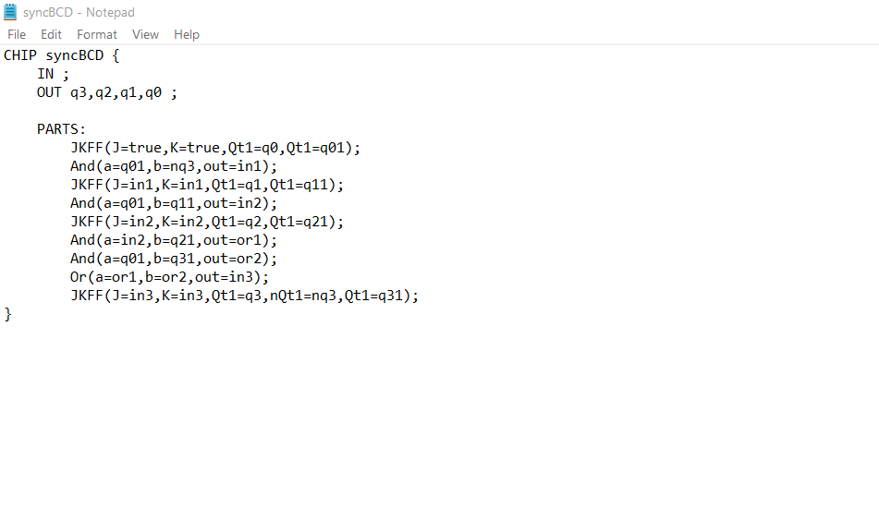

Slide 48
OUTPUT

Slide 49
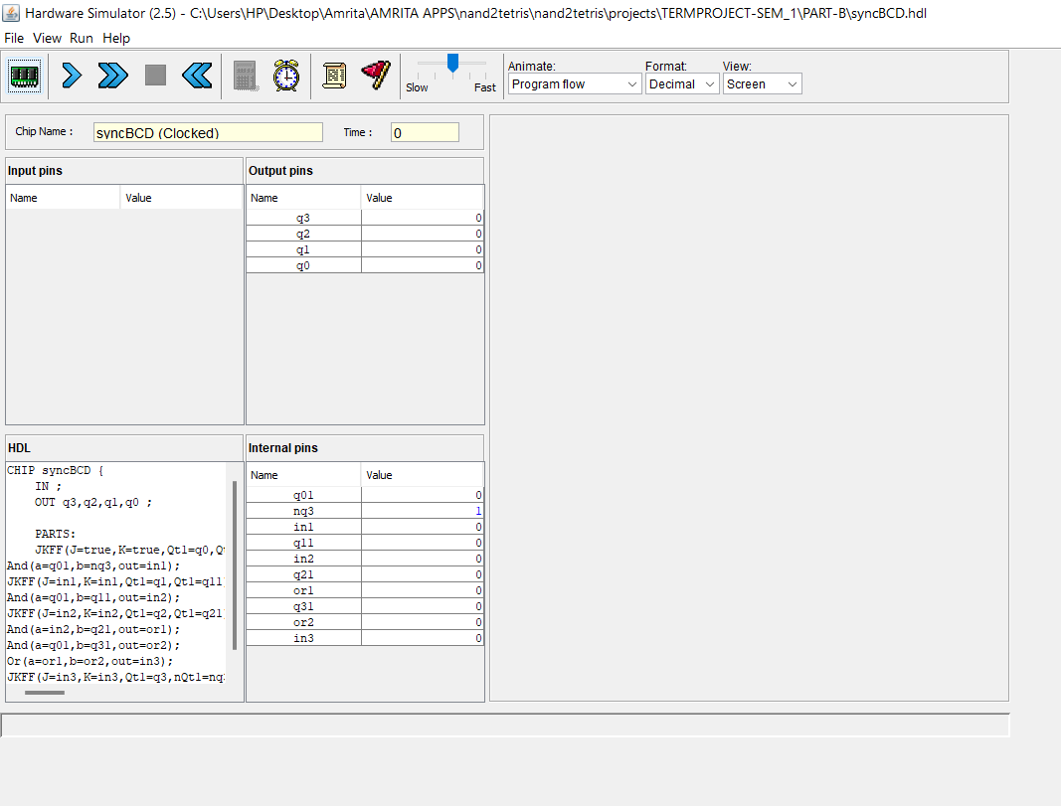

Slide 50
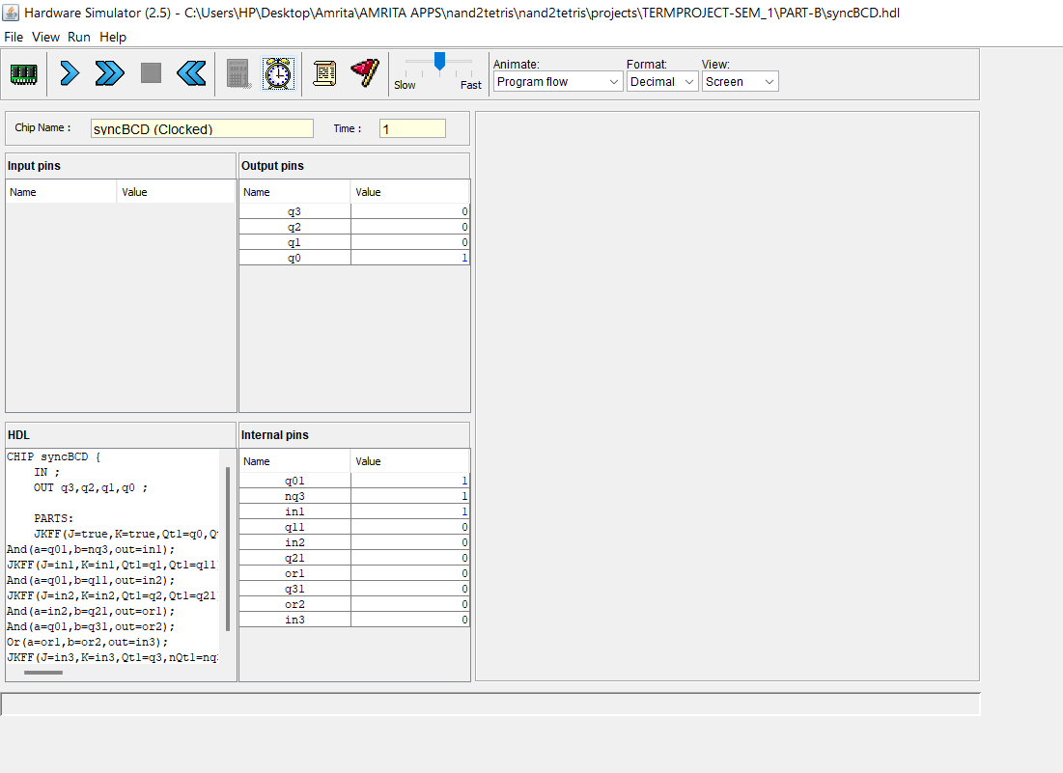

Slide 51
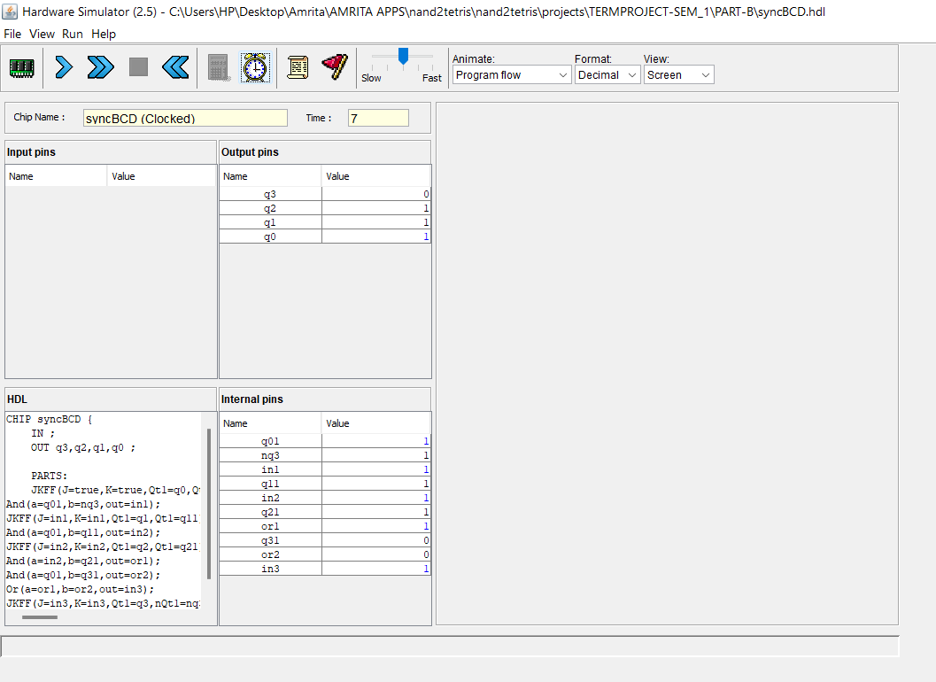

Slide 52
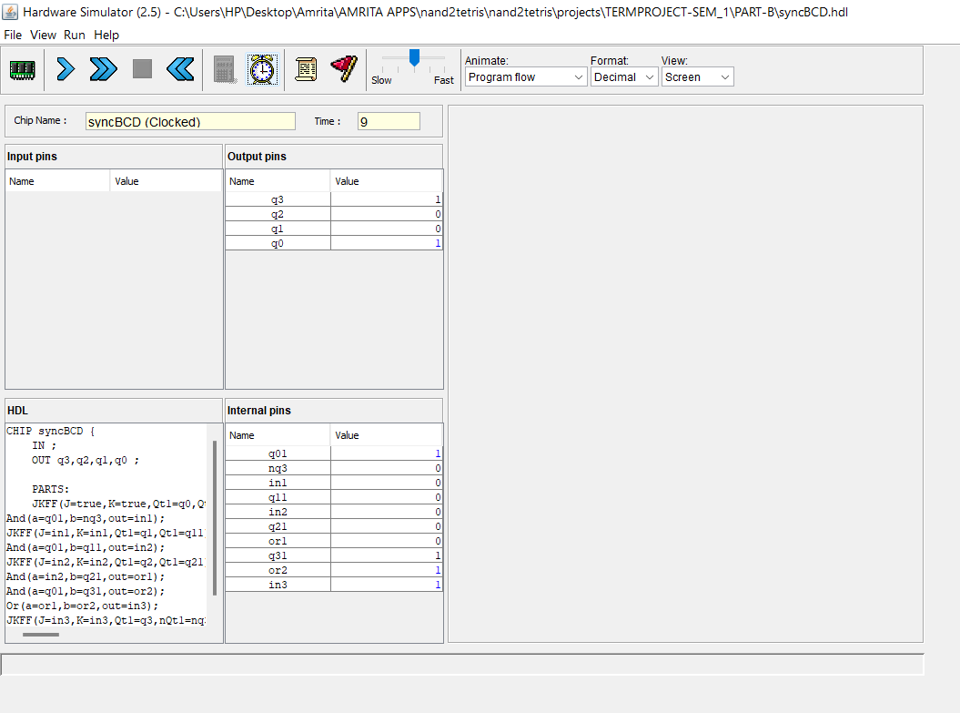

Slide 53
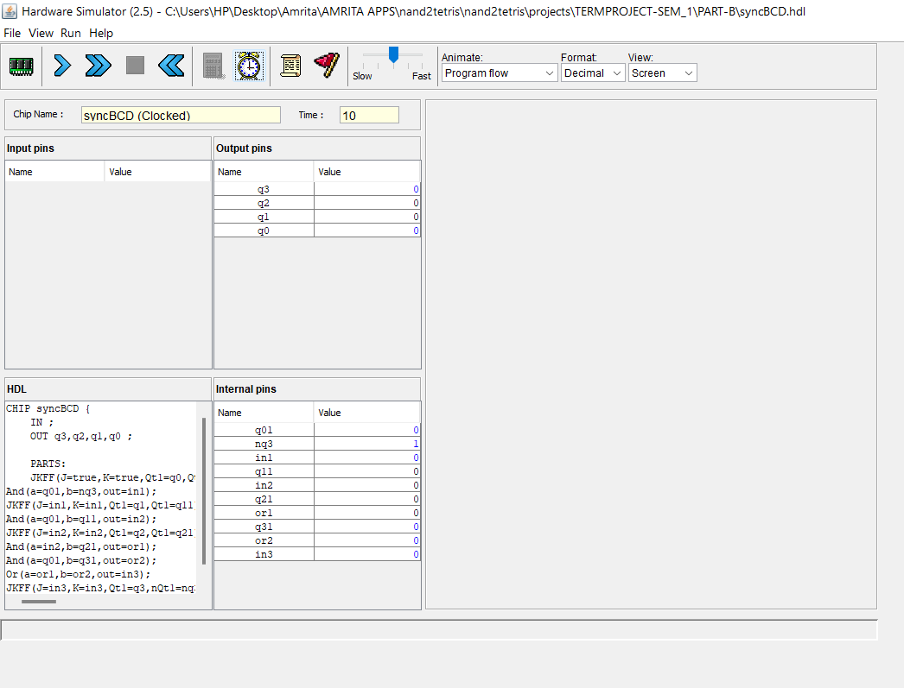

Slide 54
Structure of program

Slide 55
ALU
MAIN
FULL ADDER
AND,AND16
OR, OR16
ADD16
HALF ADDER
NAND
MUX
DEMUX

Slide 56
CODES

Slide 57
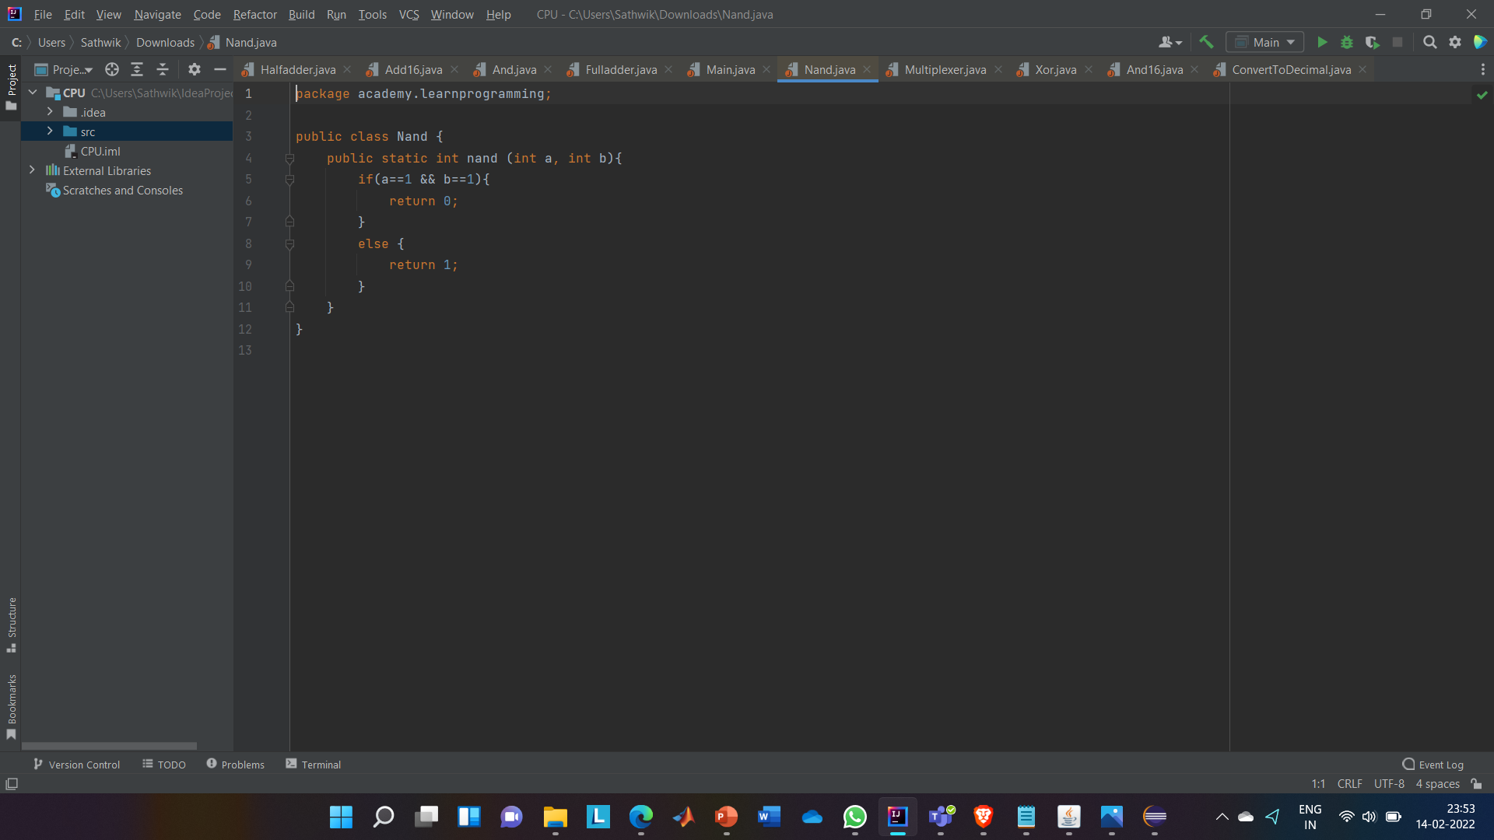
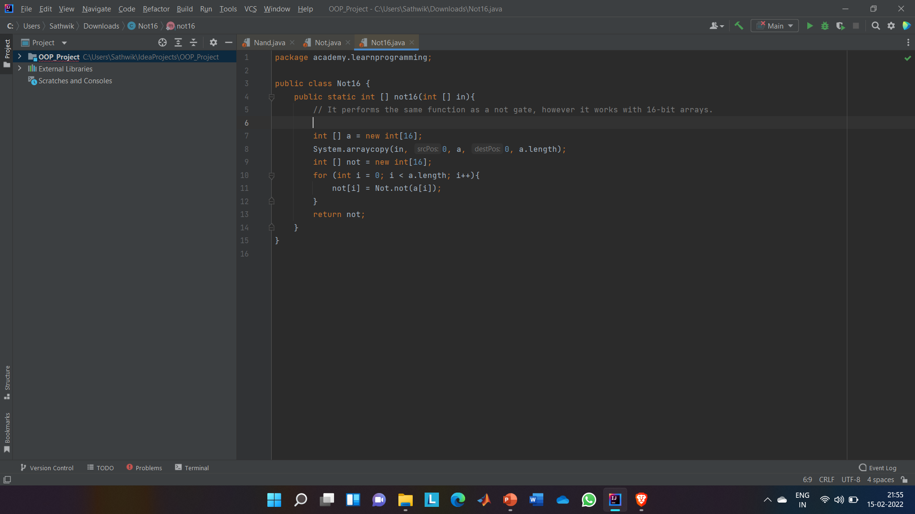
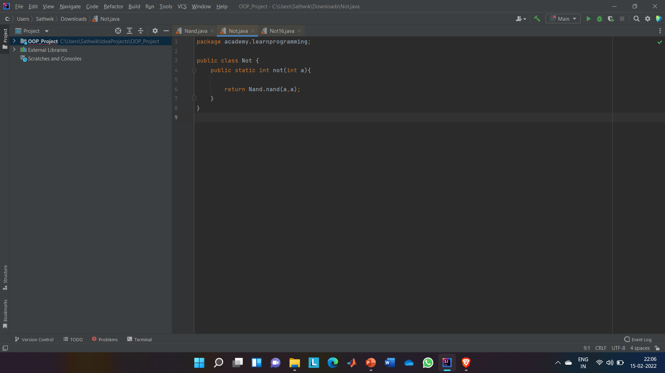
Nand Gate
Not
NOT16
// We can't make a Not gate from a Nand gate by combining the Nand gate's two inputs.
// return -a;
// bitwise not / bitwise complement

Slide 58
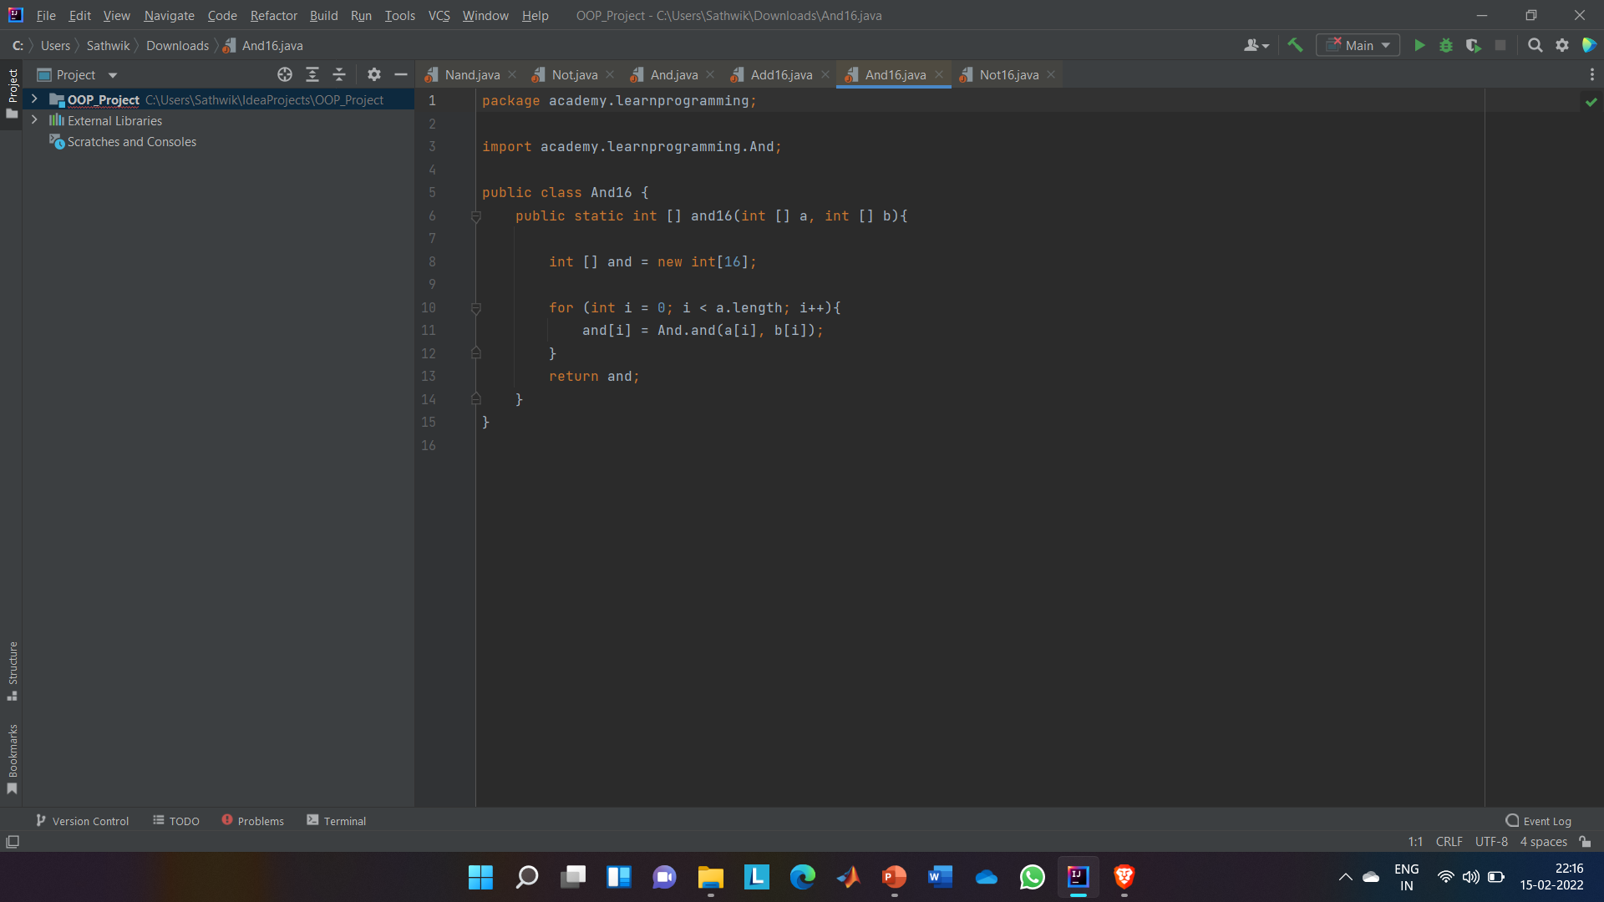

AND AND16
// Z = A’B+AB’
// It is also a complement of nand (a,b)

Slide 59
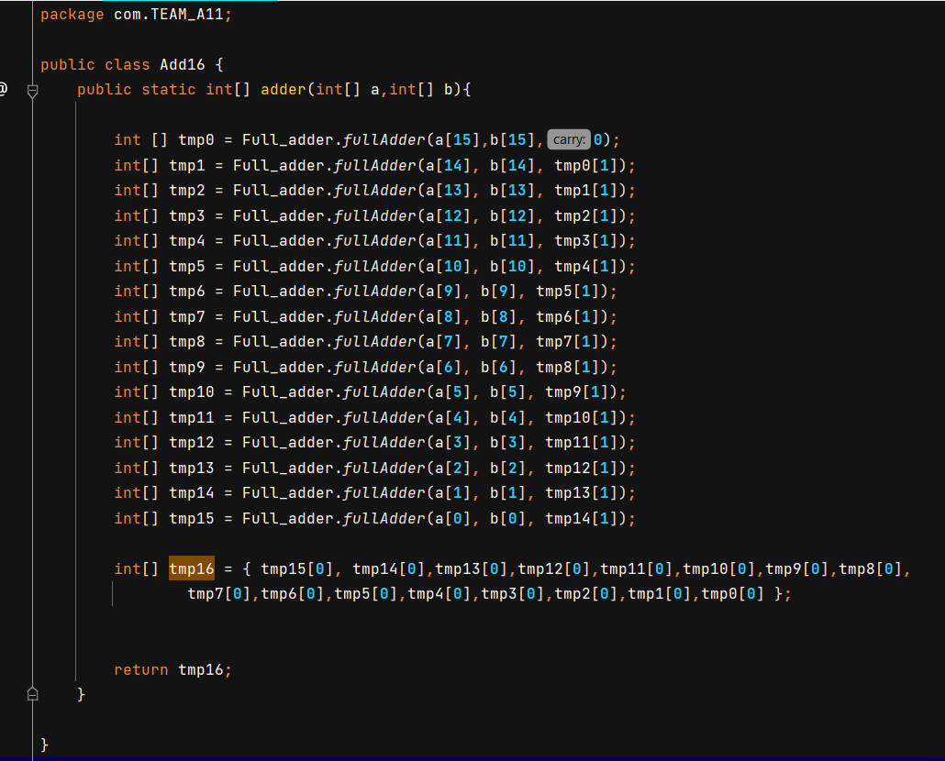
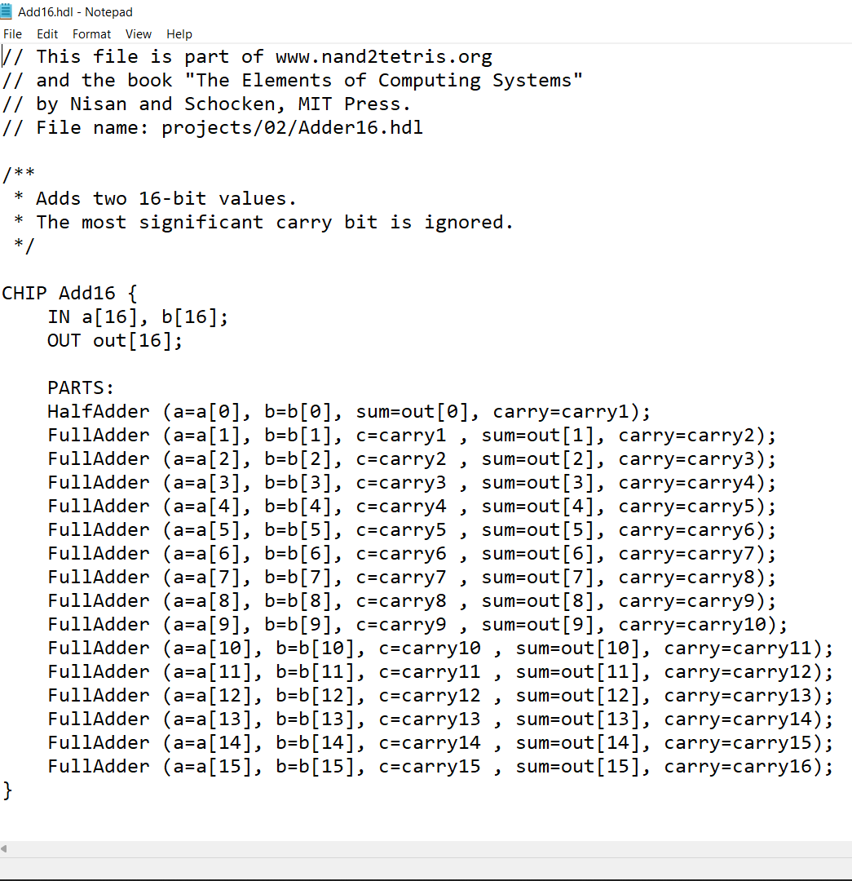
ADD16

Slide 60
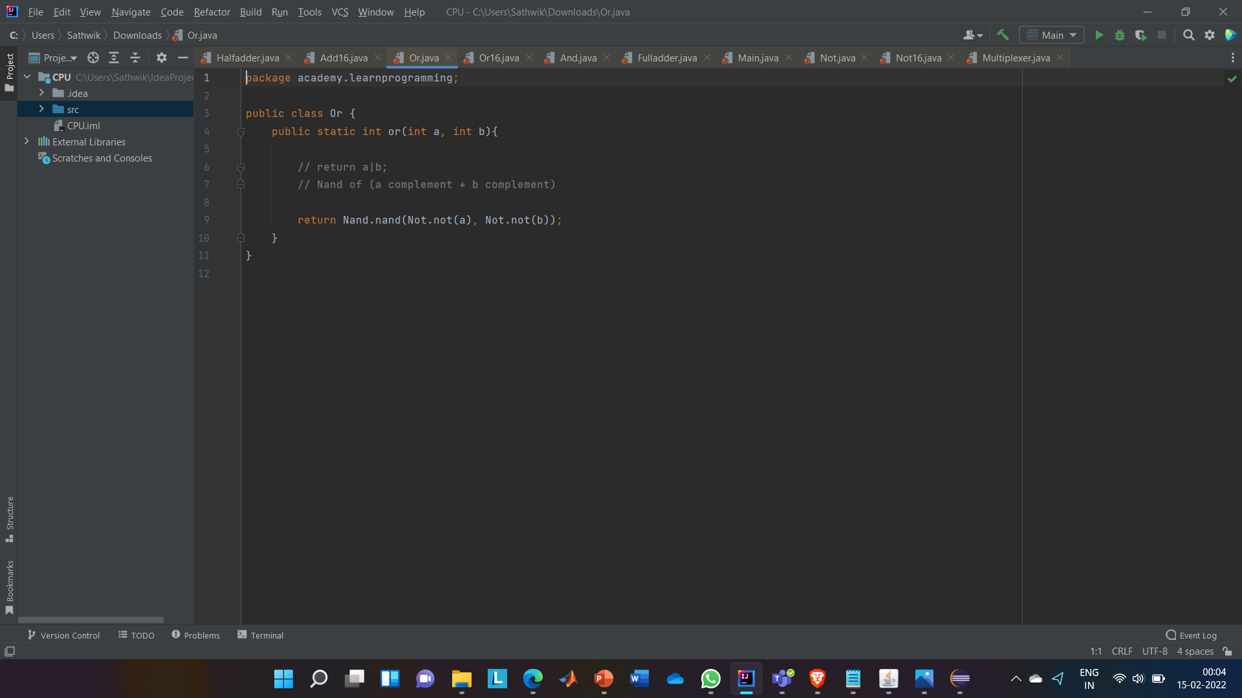
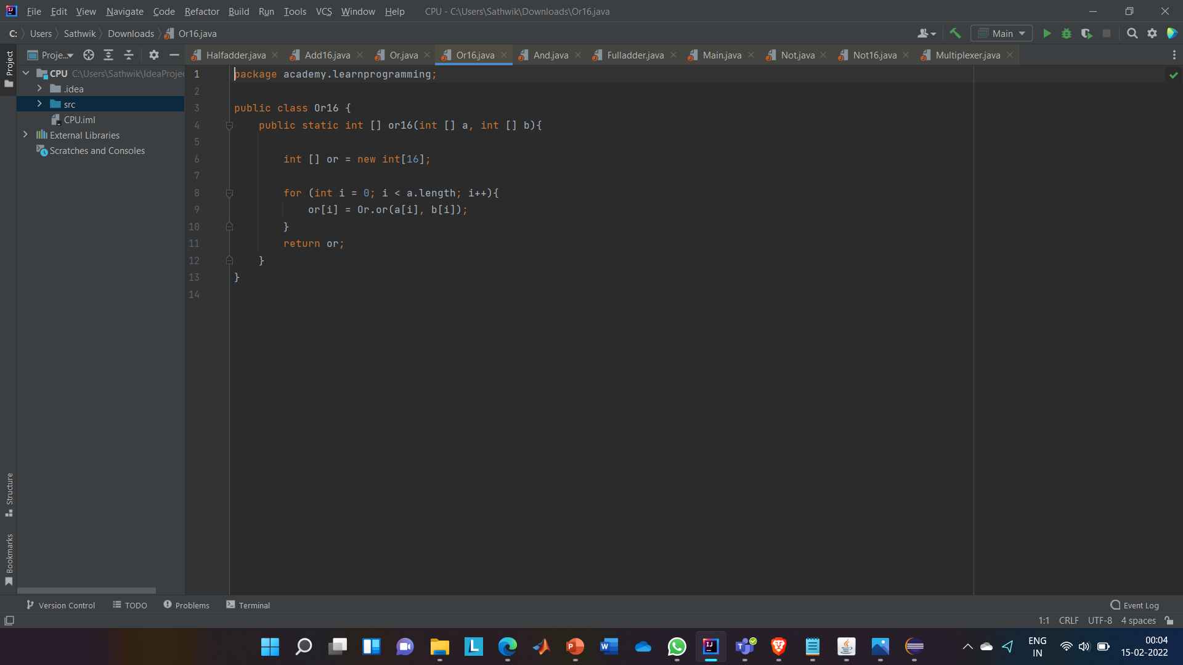
OR OR16

Slide 61
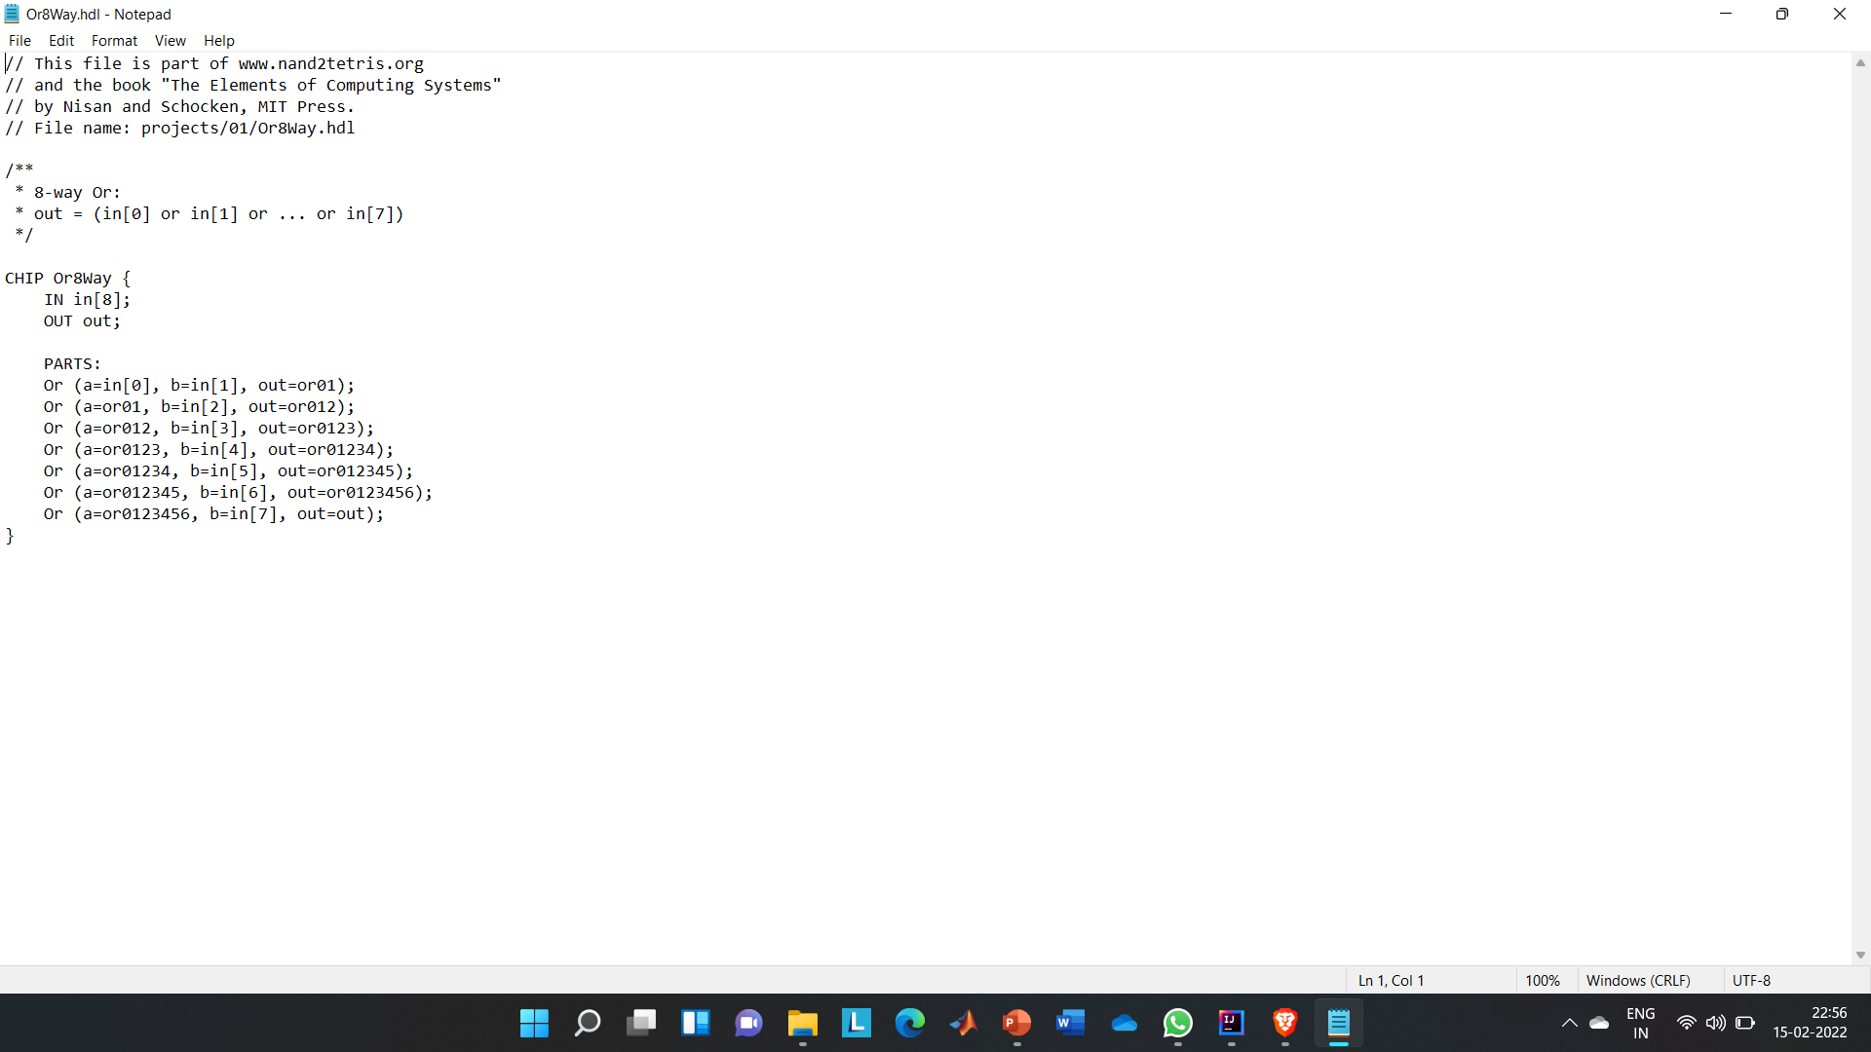
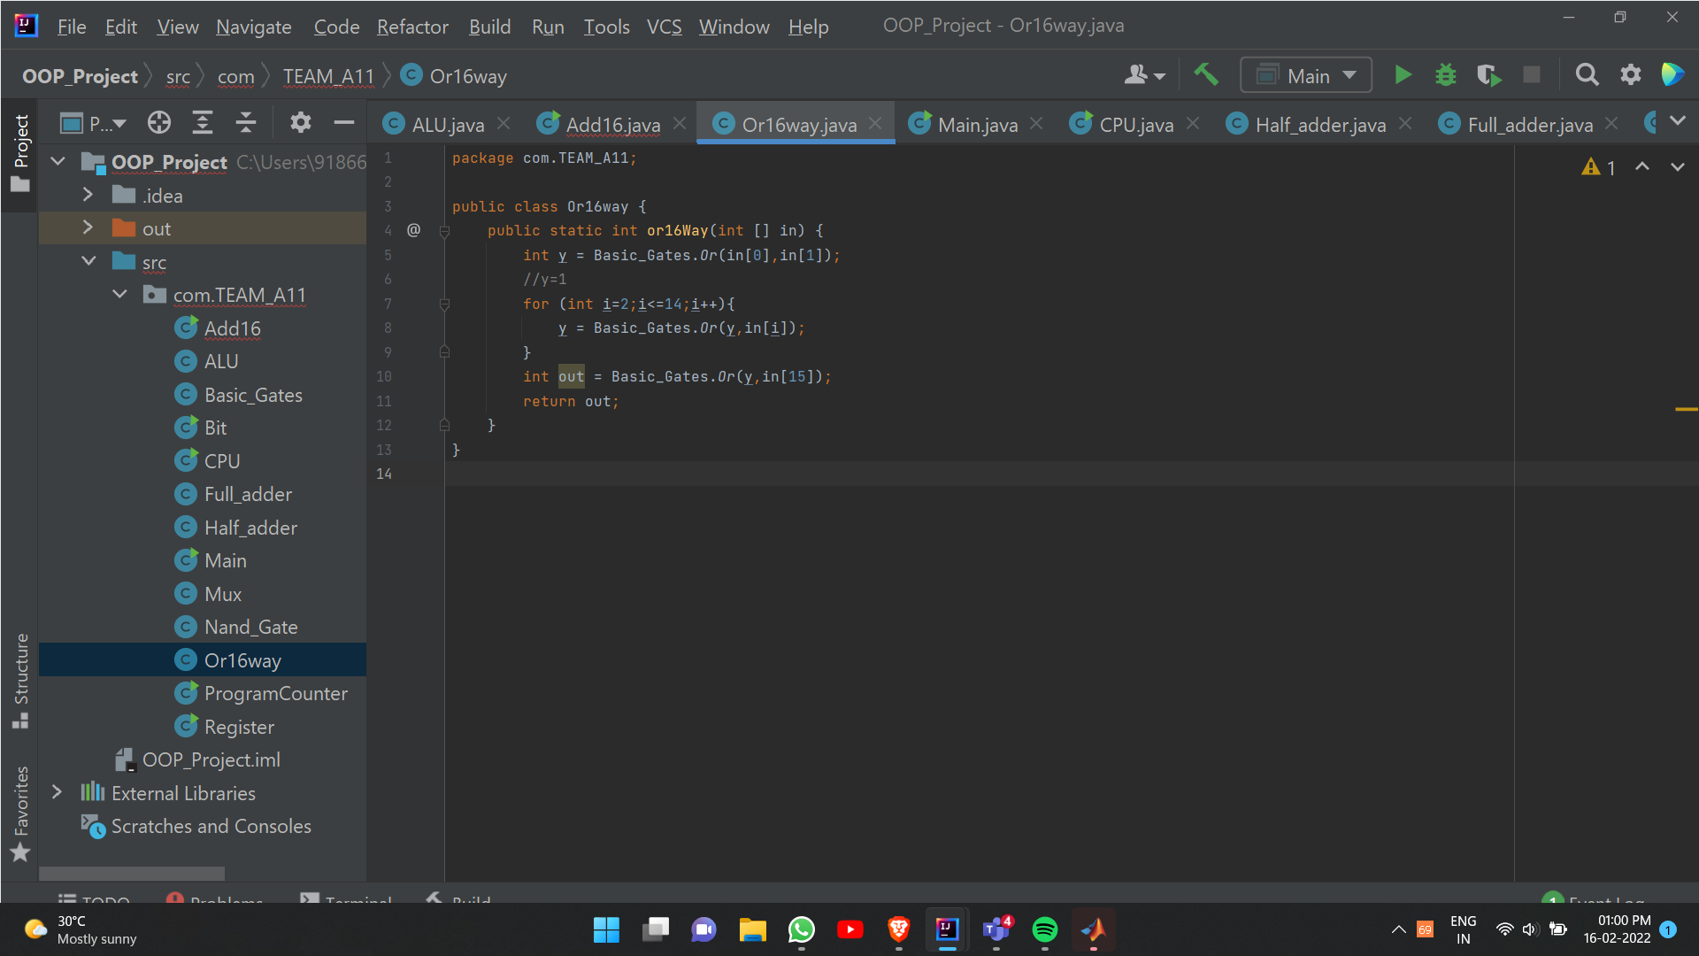
ORWAY16

Slide 62
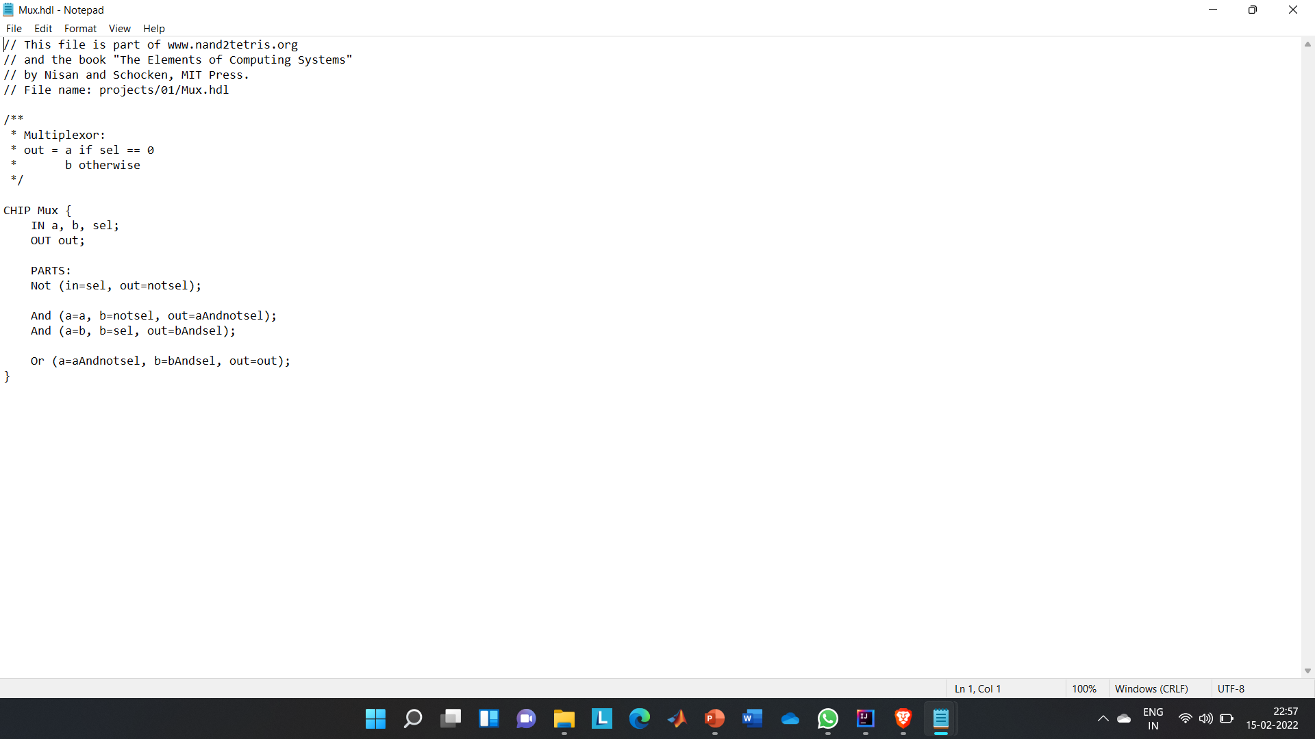
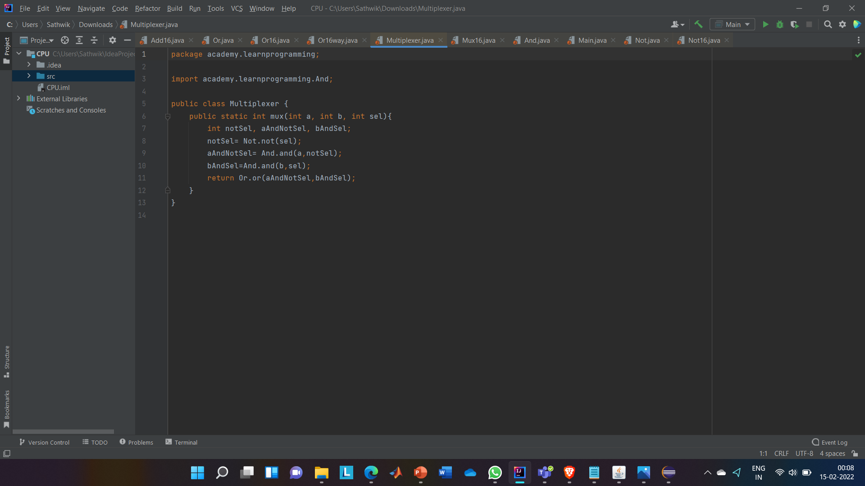
MUX

Slide 63
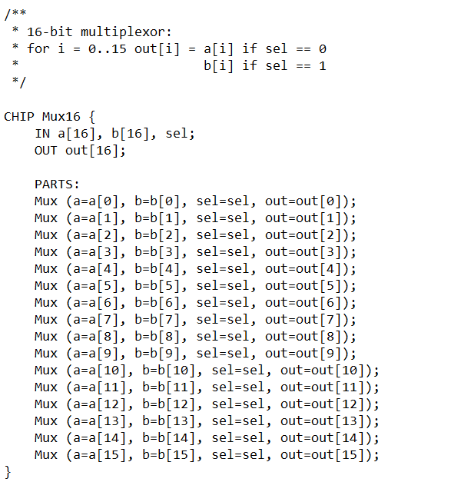

MUX16

Slide 64



XOR, HALF ADDER AND FULL ADDER

Slide 65


ALU

Slide 66


CONVERT TO DECIMAL
MAIN

Slide 67

OUTPUT

Slide 68



D FLIP FLOP (DESIGN);
JK FLIP FOP ( DESIGN);

Slide 69

D FLIP FLOP ;

Slide 70




AND;
NAND GATE;
NOT;
OR;

Slide 71


JK FLIP FLOP ( USING HDL CODES AND BASIC GATES) ;
HDL CODE;

Slide 72


SYNCHRONOUS BCD COUNTER ( WITHOUT USING GATES) ;

Slide 73
Thank you!

